Slide 1

Re:Book
CS300-Group 05

Slide 2
Table of contents
03
01
Software requirements
Problem statement
Analysis and design
Project management
04
02
Problem statement, product position statement, user/market
Use-case model, non-functional requirements
Team structure and responsibilities of team members.
Architecture and technologies used

Slide 3
Table of contents
05
Software testing
Demo
06
Test environments, test plan, and test results
Demo a key scenario of the software

Slide 4
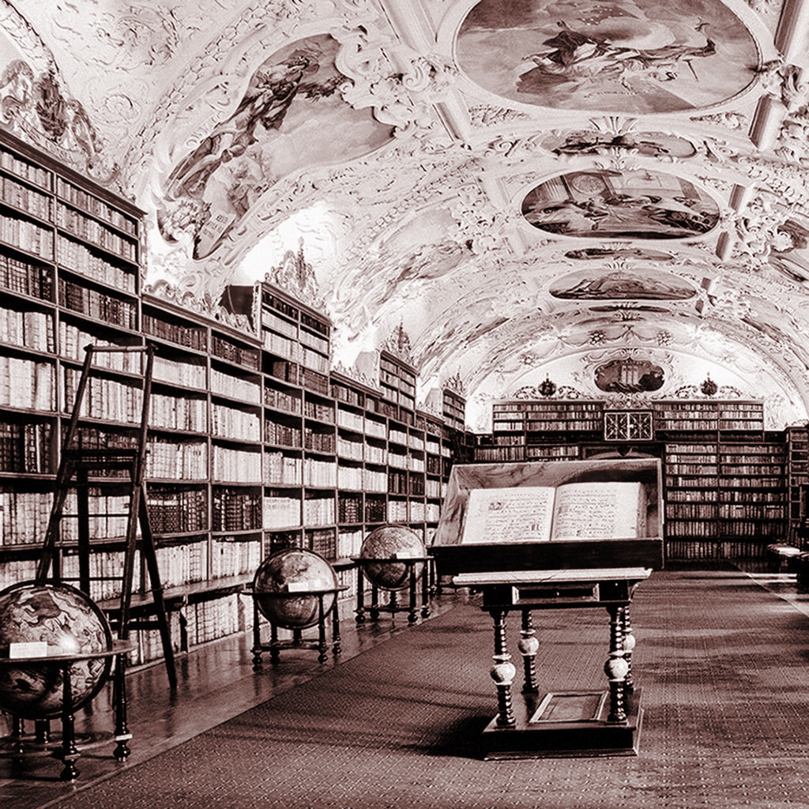
01
Problem statement
Problem statement, product position, statement, user/market

Slide 5
Problem Statement
The problem of | The front-end of Goodreads which lacks of aesthetic patterns and responsive features from the present time
affects | Users in the modern era
the impact of which is | A quite tedious experience and dissatisfaction of having almost no upgrade in terms of vision and features
a successful solution would be | Keep some fundamental functions of a book-review website and improve the image of the website.

Slide 6
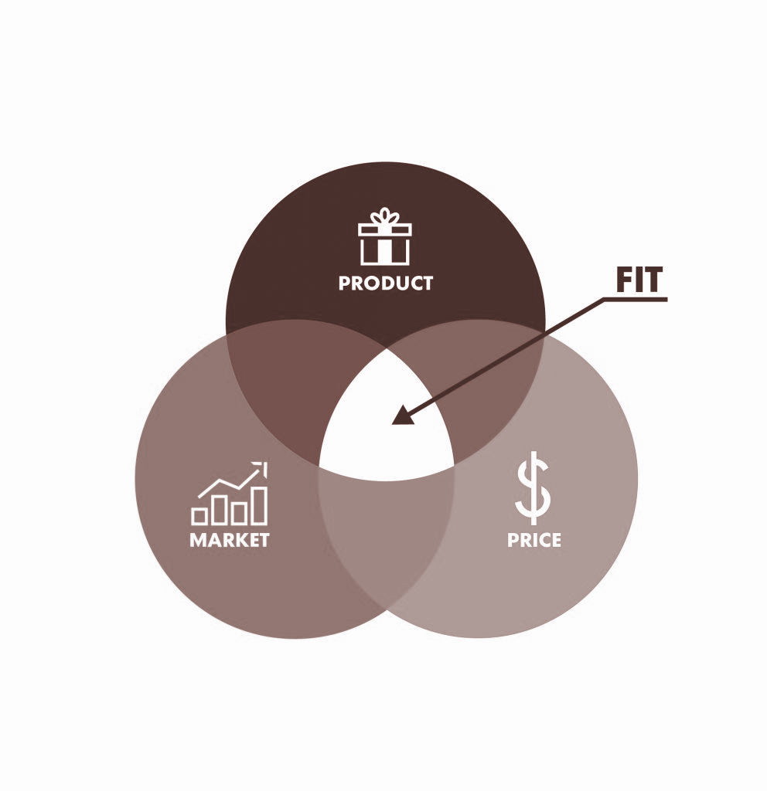
Product Position Statement
For | Online users with no age limit
Who | Review books
Re:Book | Is a website
That | Enables online users to review their books, see other reviewing versions and read books (if exist)
Inspired by | The existing Goodreads website
Our product | Provides a better visual representation with the adaption of responsive features coming from modern design

Slide 7
For | Online users with no age limit
Who | Publish a book
Re:Book | Is a website
That | Enables online users to publish or update the information for books
Inspired by | The existing Goodreads website
Our product | Provides a better visual representation with the adaption of responsive features coming from modern design
For | Online users with no age limit
Who | Find the link to ebooks
Re:Book | Is a website
That | Enables online users to find and read ebooks quickly
Inspired by | The existing Goodreads website
Our product | Provides a better visual representation with the adaption of responsive features coming from modern design

Slide 8
User/Market
01
02
03
04
The Re:Book website will be used by people , regardless of hobby, with a passion for reading, reviewing, and writing books.
The Re:Book website could provide an interface for bookaholics to read and review books
The users could:
Get a link to the ebook
Review for the books
Update book’s information to the website
The website should be able to perform any actions that the readers require

Slide 9
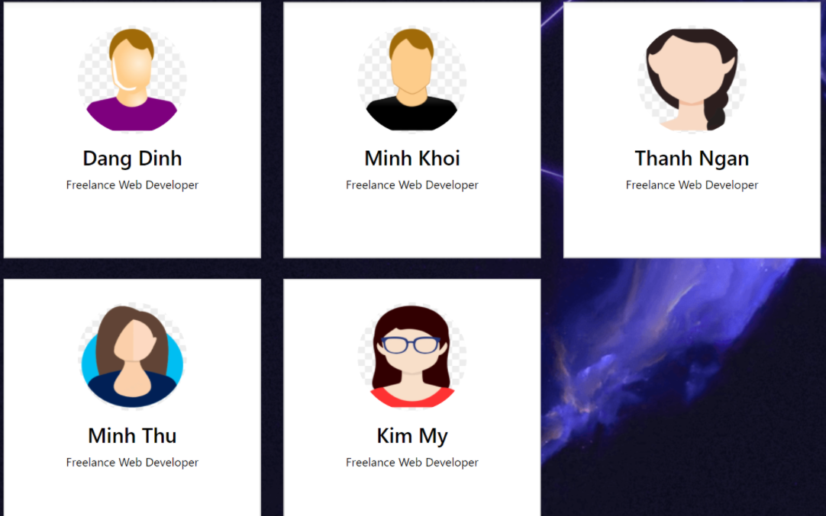
02
Project management
team structure and responsibilities of team members

Slide 10
Team Members
19125136 - My Le: Project manager, Developer
19125039 - Dinh Dinh: Designer, Developer, Business Analyst
19125054 - Khoi Quach: Developer, Tester, Business Analyst
19125060 - Ngan Nguyen: Developer, Database Designer, Tester
19125123 - Thu Nguyen: Developer, Test Manager

Slide 11
Le Thi Kim My
Dinh Dang Dinh
Project Manager
UI/UX Designer
Front-end Developer
UI/UX Designer (Main Role)
Front-end Developer
Tester

Slide 12

Quach Minh Khoi
Nguyen Thanh Ngan
Nguyen Minh Thu
Front-end Developer
Documents (Main)
Tester
Front-end Developer (Main role)
Database Designer
Tester
Database Designer
Tester (Main role)

Slide 13

03
Software Requirement
Use-case model, non functional requirements

Slide 14
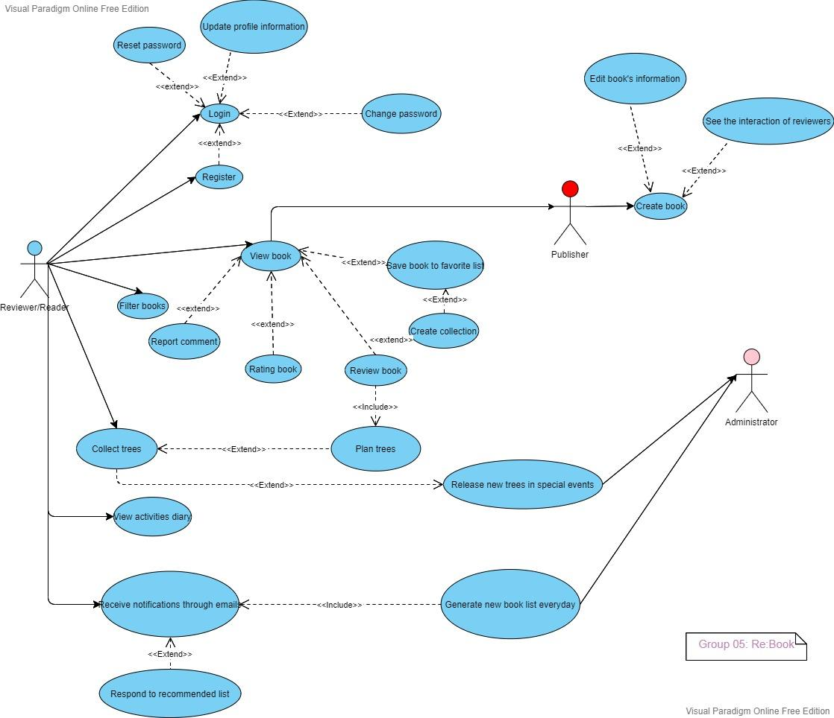
Use-case model

Slide 15

Non functional requirements
Applicable Standards
We aim to create responsible websites which are suitable with varied screen
System requirements
The website runs on the web browser
Performance requirements
100 - 500 users
Environmental requirements
Window 10, 11; Internet

Slide 16
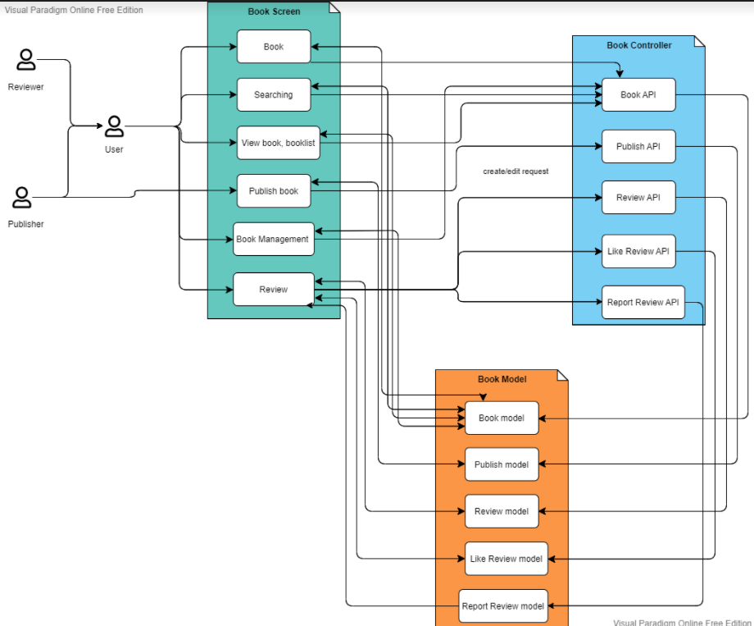
04. Analysis
and design

Slide 17

05
Software testing
Test environments, test plan, and test results

Slide 18
Test plan
Create books
Sign up
Log in
Edit profile
When you cannot find a book on website, you can create it for everyone to review
Register for the first time login by username and password
Have the ability to log in by existing account name and password.
Edit and update the user’s information, Upload image from local folder to set avatar

Slide 19

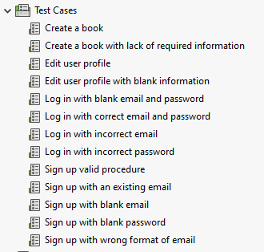
Test cases

Slide 20
Test environments
100%
100%
Hardware Requirements
Software Requirement
Computers connecting to the internet.
Firefox, Chrome : Internet Browser
Operating System
Katalon : Testing Application

Slide 21
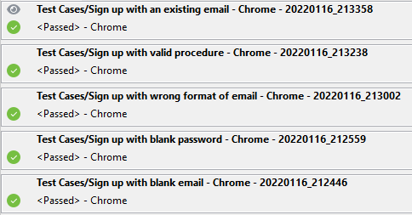
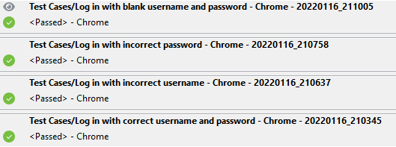
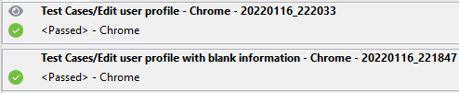
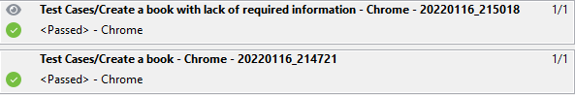
Result of testing

Slide 22
DEMO

Slide 23

Thanks
Do you have any questions?
Lê Thị Kim Mỹ - ltkmy19@apcs.fitus.edu.vn
Nguyễn Thanh Ngân - ntngan19@apcs.fitus.edu.vn
Quách Minh Khôi - qmkhoi19@apcs.fitus.edu.vn
Nguyễn Minh Thư - nmthu19@apcs.fitus.edu.vn
Đinh Đăng Định - dddinh19@apcs.fitus.edu.vn

